Slide 1
English for
International
Communication

Slide 2
實戰篇 Unit 3
「簡短對話」
主題類型與詞彙

Slide 3
實戰篇 Unit 3
本單元要來學習「簡短對話」常考主題的相關詞彙，並針對各類主題做聽力練習。首先我們來看看各類主題可能包含哪些談話內容。
主題1 | Offices 辦公室 | • 辦公設備與器材 • 工作流程 • 工作計畫
主題2 | General Business 一般商務 | • 會議 • 企業文化 • 合約 • 業務拜訪或推銷 • 企業合併 • 公司產品或服務
主題3 | Finance 金融 | • 經濟狀況 • 投資 • 市場趨勢 • 銀行業務

Slide 4
實戰篇 Unit 3
主題4 | Personnel 人事 | • 聘僱 • 升遷 • 面試 • 員工訓練
主題5 | Business Trip / Travel 出差／旅遊 | • 搭機 • 換鈔結匯 • 飯店住宿 • 觀光資訊
主題6 | Transportation 交通 | • 大眾運輸 • 租車 • 票務 • 問路
主題7 | Dining 餐飲 | • 餐廳訂位 • 商務／非正式午餐 • 點餐 • 招待會／宴會
主題8 | Shopping 購物 | • 門市 • 保固 • 結帳 • 售後服務

Slide 5


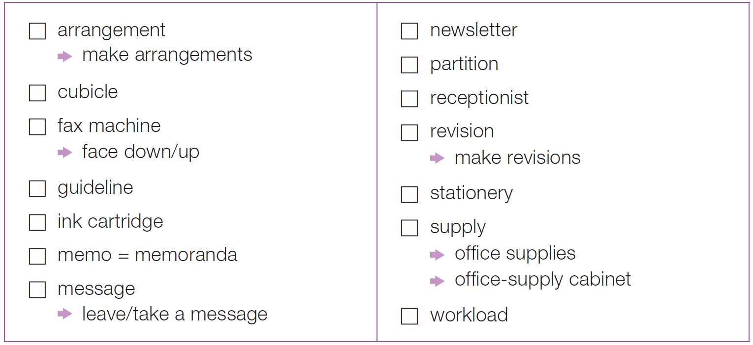
實戰篇 Unit 3
Word Power
將以下你已認識的字詞打，並在右方寫下其中文意思。
(n.) 安排；準備工作
(n.) 時事通訊；商務通訊
安排
(n.) (辦公室的) 隔牆；隔板
(n.) 辦公室隔間
(n.) 接待員
傳真機
(n.) 修訂；校訂
正面朝下/上
修改；修訂
(n.) 指導方針
(n.) 文具
墨水匣
(v./n.) 供給；供應 (品)
(n.) 備忘錄
辦公室用品
(n.) 訊息；留言
辦公室用品櫃
(n.) 工作量
留下/記下訊息或留言

Slide 6
實戰篇 Unit 3
Exercise
Conversation 1
Q: What does the man like about the desk?
(A) It has a lot of software.
(B) It is a sizable desk.
(C) The window has a good view.
(D) The desk has a good computer.
錄音內容
W: Welcome to your new office. This is your desk. Will you need any special supplies or anything?
M: I’ll only need stationery—pens, pencils and so on. Hey, this desk has a pretty good view.
W: Yes, this window looks out onto the park. Now, let me show you how to log onto your computer.
M: Great. I’ll probably have a lot of questions about the company’s software.
• log onto 登入

Slide 7
實戰篇 Unit 3
中文翻譯
女：歡迎來到你的新辦公室。這是你的桌子，你有需要哪些特別用品或是其他東西嗎？
男：我只需要文具—原子筆、鉛筆等等。嘿，在這個座位可以看到很棒的景色呢。
女：對啊，這扇窗戶可以遠眺公園。現在，讓我為你示範該如何登入電腦。
男：好極了，我可能會有很多關於公司軟體方面的問題。

Slide 8
實戰篇 Unit 3
Conversation 2
Q: What is the relationship between the speakers?
(A) Customer–supplier
(B) Coworkers
(C) Machine repairer–machine owner
(D) Telephone operator–caller
錄音內容
M: Do you know why our faxes are so faint? I can hardly read the message.
W: The fax machine needs a new ink cartridge. Didn’t Greg say he bought an extra one last time? He would have put it in the office-supply cabinet.
M: I think we used that last one. Do you have time to go to the store? I can give you the company credit card to buy a new one.
W: Not really. I’ll ask Jenny if she can go.
• faint (adj.) 暗淡的；模糊的

Slide 9
實戰篇 Unit 3
中文翻譯
男： 妳知道為什麼我們的傳真機印出來的字會那麼模糊嗎？我幾乎都看不到訊息了。
女： 傳真機需要新的墨水匣。葛瑞格不是說他上次多買了一個嗎？他應該把它放在辦公用品櫃裡了。
男： 我想我們已經用了那最後一個，妳有時間去店裡買嗎？我可以給妳公司信用卡去買一個新的。
女： 我可能沒空，我問看看珍妮能不能去買。

Slide 10

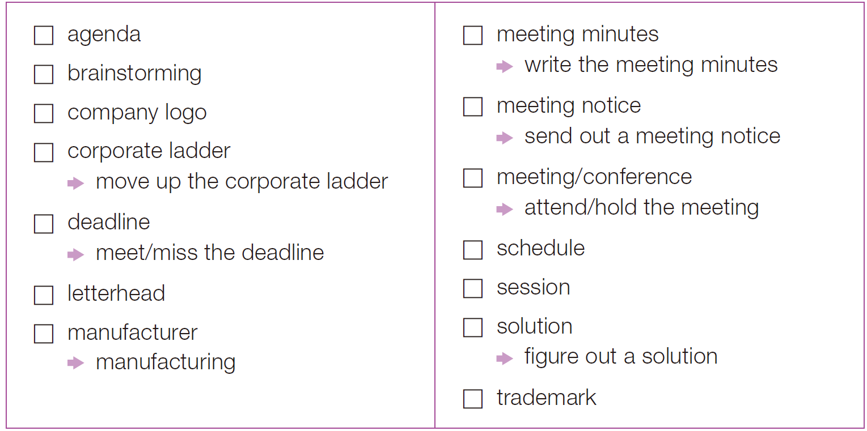
實戰篇 Unit 3
Word Power
將以下你已認識的字詞打，並在右方寫下其中文意思。
(n.) 議程
會議記錄
(n.) 集體討論；腦力激盪
撰寫會議記錄
公司商標
會議通知
發送會議通知
企業晉升階梯
獲得
晉升
(n.) 會議
參加/舉行會議
(n.) 截止日期
趕上/錯過
截止日期
(n.) 行程表
(n.) 信頭
(n.) 會議；集會、課程等的一段時間
(n.) 製造商
(n.) 解決辦法
(n.) 製造業
想出解決辦法
(n.) 註冊商標

Slide 11
實戰篇 Unit 3
Exercise
Conversation 1
Q: What date does the man suggest meeting on?
(A) The first
(B) The second
(C) The third
(D) The fifth
錄音內容
W: Let’s hold the meeting in the first week of next month. What day would be best?
M: I’m busy on November first and second. How about the third? The third is good for me.
W: Actually, let’s hold it on the fifth instead. That’s a Friday. More people will be able to come on a Friday.
M: That’s true. And we need as many people as possible to attend. I’ll send out the meeting notice and agenda by the end of the week.

Slide 12
實戰篇 Unit 3
中文翻譯
女： 我們下個月的第一個星期來舉行會議吧，哪一天最適合呢？
男： 我十一月一號和二號都很忙。三號如何呢？三號我可以。
女： 事實上，我們五號舉行會議吧。那天是星期五。星期五比較多人可以來。
男： 那倒是。而且我們需要盡可能多一點人參加會議。在這個星期結束前我會寄會議通知和相關議程。

Slide 13
實戰篇 Unit 3
Conversation 2
Q: What does the man say about Sandy?
(A) He thinks she is a favorite of the boss.
(B) He thinks she is imaginative.
(C) He thinks she is overbearing.
(D) He wishes she worked in a different department.
錄音內容
W: I just had a great brainstorming session with Sandy. Not only did we figure out a solution, we did it in less than an hour.
M: She’s always brimming with new ideas.
W: I’m surprised she hasn’t received a promotion yet. Everyone here loves her and she never misses a deadline.
M: You know how nepotism plays a role in this company. You’ll only move up the ladder if you’re the big boss’s relative!
• brim (v.) 充滿 • nepotism (n.) 任人唯親

Slide 14
實戰篇 Unit 3
中文翻譯
女： 我剛剛才和珊蒂腦力激盪了一番，而且我們不到一小時就想出了解決辦法。
男： 她總是充滿新點子。
女： 我很驚訝她到現在都還沒升職，每一個人都很喜歡她，而且她總是按時完成工作。
男： 妳也知道這間公司有多重視皇親國戚。如果妳是大老闆的親人，才能順利晉升！

Slide 15

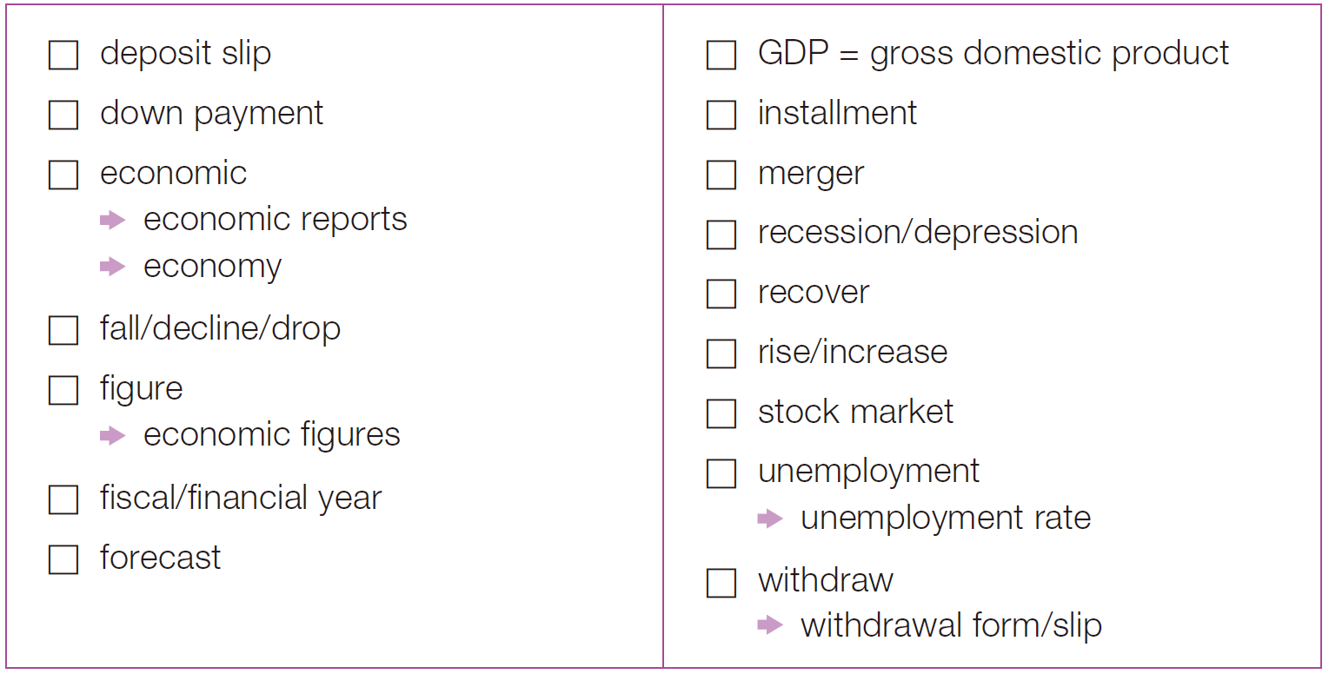
實戰篇 Unit 3
Word Power
將以下你已認識的字詞打，並在右方寫下其中文意思。
存款單
國內生產
總值
分期付款的頭款
(n.) 分期付款
(adj.) 經濟上的
(n.) 合併
經濟報告
(n.) 衰退
(n.) 經濟
(v.) 恢復
(v.) 下降；下跌
(v.) 上升；攀升
(n.) 數字；圖表；圖解
股市
經濟數據
(n.) 失業
會計/財務年度
失業率
(n.) 預測
(v.) 提款
提款單

Slide 16
實戰篇 Unit 3
Exercise
Conversation 1
Q: What are the two speakers mainly talking about?
  (A) Poor government reports
  (B) Rising retail prices
  (C) Economic troubles
  (D) Finding new jobs
錄音內容
M: There were some good economic reports out from the government this week.
W: I hope that means the economy is getting better. Unemployment is at an all-time high.
M: The stock market was up over the last few days, too. Hopefully, the market is recovering.
W: Hopefully! I lost a lot of money when it fell.
• all-time (adj.) 空前的；創紀錄的

Slide 17
實戰篇 Unit 3
中文翻譯
男： 政府這星期發布了一些不錯的經濟報告。
女： 我希望這代表經濟開始好轉，現在的失業率已經創新高了。
男： 在過去這幾天，股票市場也逐漸回升，希望市場逐漸復甦。
女： 希望是這樣囉！股票下跌的時候我損失了很多錢。

Slide 18
實戰篇 Unit 3
Conversation 2
Q: What does the man say about public borrowing in Japan?
(A) It is more than two times GDP.
(B) It is 20 times more than GDP.
(C) It is 200 times more than GDP.
(D) It is less than GDP.
錄音內容
M: I’ve just read that GDP may increase by nearly 9 percent in parts of Asia this year.
W: I saw that report, but I don’t think those figures included Japan. Experts think the average wage will not rise there by as much as other countries in Asia.
M: Right, the economy is still struggling in Japan, and public borrowing is now more than 200 percent of GDP.
W: Exactly. No wonder the finance minister just quit after a few months.
• public borrowing 公共借貸（意同 public debt「公共債務」，即公債；國債）

Slide 19
實戰篇 Unit 3
中文翻譯
男： 我剛剛才看到今年亞洲某些地區的國內生產總值可能會成長近九個百分點。
女： 我有看到那篇報導，但我不認為那些數據包括日本。專家認為日本平均薪資的上升幅度可能不會像亞洲其他國家一樣多。
男： 對，日本的經濟仍然不景氣，現在的公債更是超過國內生產總值的兩倍。
女： 沒錯。難怪財政部長做了幾個月就辭職了。

Slide 20

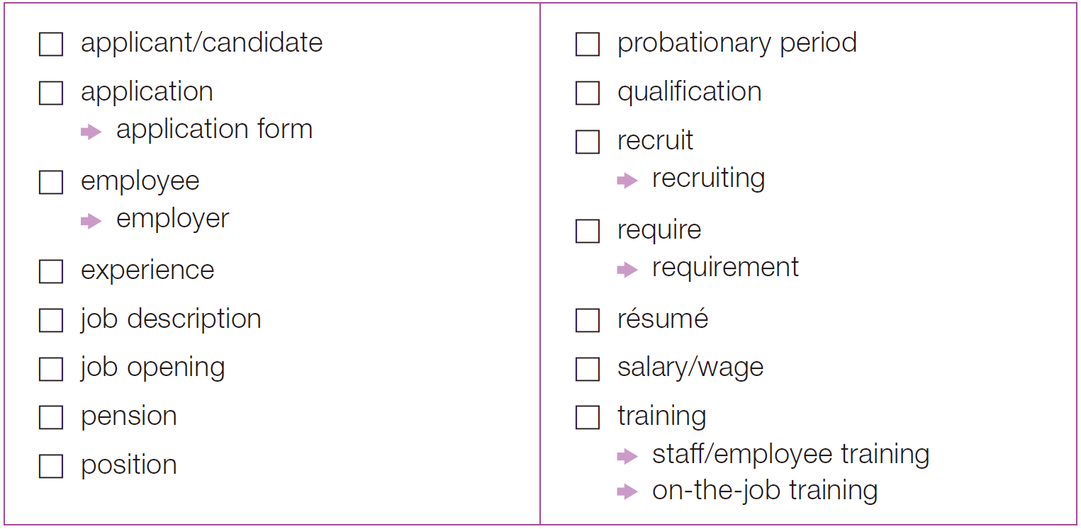
實戰篇 Unit 3
Word Power
將以下你已認識的字詞打，並在右方寫下其中文意思。
(n.) 申請人；候選人
試用期
(n.) 申請
(n.) 資格；能力
申請表
(v.) 徵募(新兵)；吸收(新成員)
(n.) 員工
(n.) 招聘
(n.) 雇主
(v.) 要求
(n.) 經驗
(n.) 要求
工作說明
(n.) 履歷表
職缺
(n.) 薪資
(n.) 退休金
(n.) 訓練
(n.) 職位
員工訓練
在職訓練

Slide 21
實戰篇 Unit 3
Exercise
Conversation 1
Q: What experience will help the man?
  (A) He has worked in other countries.
  (B) He has sold software.
  (C) He has written résumés.
  (D) He has many contacts in Germany.
錄音內容
W: Well, looking at your résumé, I see you have 15 years’ experience in marketing. Why are you interested in working for our company?
M: I’ve always wanted to work for a multinational company like this. I’m interested in international marketing campaigns.
W: This position requires experience abroad. Do you have experience working overseas?
M: Yes. I spent four years working with software companies in Germany.
• multinational (adj.) 跨國的 • campaign (n.) 活動；運動

Slide 22
實戰篇 Unit 3
中文翻譯
女： 嗯，看了你的履歷表，我發現你有十五年的行銷經驗，你為什麼會想要在我們公司工作呢？
男： 我一直都想要為這樣的跨國公司工作，我對國際行銷事務非常有興趣。
女： 這個職位需要海外經驗，你有在國外工作的經驗嗎？
男： 有，我在德國的軟體公司工作了四年。

Slide 23
實戰篇 Unit 3
Conversation 2
Q: What is most likely the woman’s relationship with the man?
(A) She is his secretary.
(B) She is his boss.
(C) She is his sister.
(D) She is a trainee.
錄音內容
W: We have two new employees who need training. What’s the earliest you can begin training them and how long will it take?
M: I can start as soon as I get in Monday morning. Do they have any experience?
W: They both have a little experience. They seem pretty sharp, too.
M: Well, then I should be able to train them faster than usual—by late Tuesday if you want me to.
• sharp (adj.) 頭腦清楚的；精明的

Slide 24
實戰篇 Unit 3
中文翻譯
女： 我們有兩位新進員工需要受訓，你最快什麼時候可以開始進行訓練，還有會花多久時間呢？
男： 我星期一早上來的時候就可以開始了，他們有經驗嗎？
女： 他們都有一點經驗，他們看起來也滿精明的。
男： 嗯，那我應該會比平常更快訓練完他們，如果你想要快點的話，星期二稍晚就可以結束了。

Slide 25

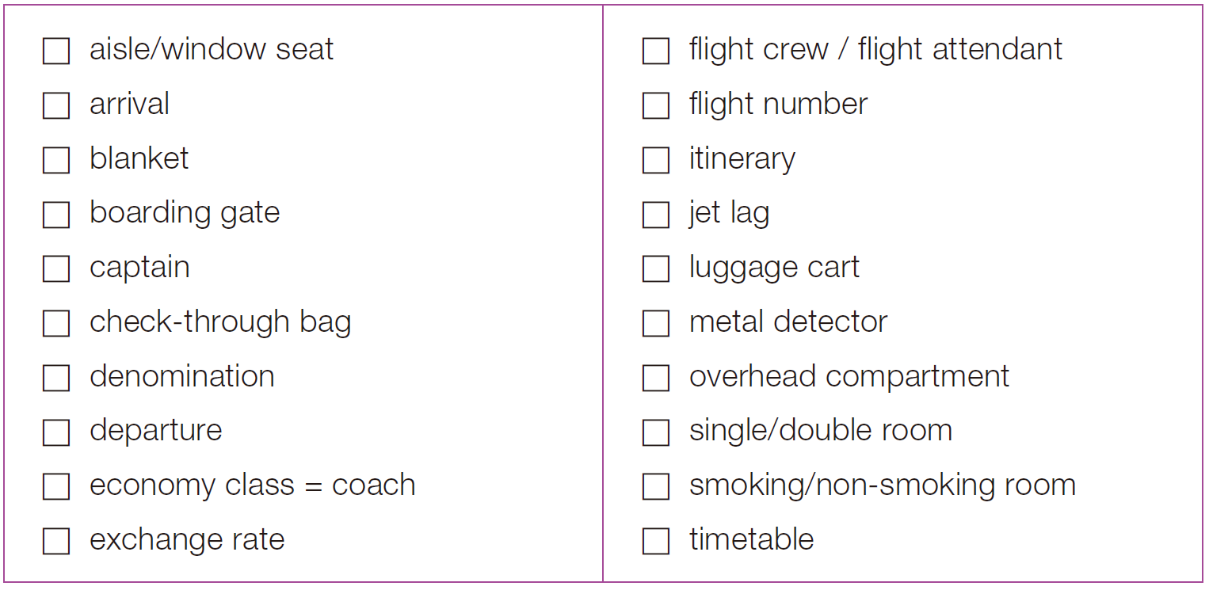
實戰篇 Unit 3
Word Power
將以下你已認識的字詞打，並在右方寫下其中文意思。
走道靠窗的位子
機組人員；
空服員
(n.) 抵達
班機號碼
(n.) 毛毯
(n.) 旅行計畫；路線
登機門
時差
(n.) 機長
行李推車
託運行李
金屬探測器
(n.) (貨幣的)面額
(機艙內的) 頭頂置物櫃
(n.) 出發
單人房/雙人房
經濟艙
吸菸房間/
非吸菸房間
匯率
(n.) (火車、飛機等) 時刻表

Slide 26
實戰篇 Unit 3
Exercise
Conversation 1
Q: Where is the man?
  (A) In a restaurant
  (B) In a hotel
  (C) On an airplane
  (D) On a train
錄音內容
W: Let me put your bag in the overhead compartment for you. Would you like a blanket and a pillow?
M: No, thanks. I never can sleep when flying. Do you have a newspaper or magazine?
W: Yes, just a moment . . . Here you are. Can I get you something to drink?
M: Yes, a cup of tea would be excellent. Thank you.

Slide 27
實戰篇 Unit 3
中文翻譯
女：讓我幫您把行李放在上方的置物櫃，您有需要毯子或是枕頭嗎？
男：不，謝謝。在飛機上我都無法睡著，妳有報紙或是雜誌嗎？
女：有，請等一下……給您，需要我為您拿些飲料嗎？
男：好，一杯茶就可以了，謝謝妳。

Slide 28
實戰篇 Unit 3
Conversation 2
Q: What is the woman not satisfied with?
  (A) She doesn’t like her room.
  (B) She thinks the room is too expensive.
  (C) She thinks the exchange rate is bad.
  (D) She can’t find a bank.
錄音內容
W: Hi, I’d like to change this money into US dollars. What is the exchange rate?
M: Here at the hotel, we’re offering a rate of thirty-six NT dollars to one US dollar. Rates are down.
W: Hmm . . . Is there anywhere that offers better rates?
M: Yes. Most banks will offer better rates, though they don’t open until Monday morning.

Slide 29
實戰篇 Unit 3
中文翻譯
女： 嗨，我想要把這些錢換成美元，匯率怎麼算呢？
男： 在飯店裡，我們提供的匯率是台幣三十六元兌換成一美元。匯率下降了。
女： 嗯……有哪些地方能提供更好的匯率呢？
男： 有，大多數的銀行會提供比較好的匯率，但要等到星期一早上銀行才會開。

Slide 30

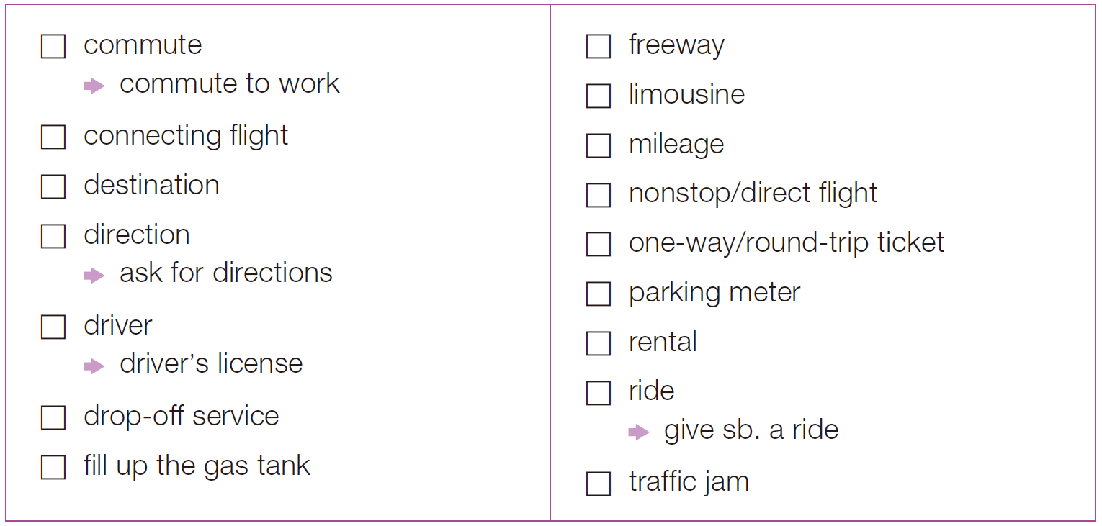
實戰篇 Unit 3
Word Power
將以下你已認識的字詞打，並在右方寫下其中文意思。
(v./n.) 通勤
(n.) 高速公路
通勤上班
(n.) 豪華轎車；加長型禮車
轉接班機
(n.) 里程數
目的地
直達班機
(n.) 方向；指示
單程/來回票
問路
停車收費器
(n.) 駕駛者
(n.) 租賃
駕照
送機服務；(租車的) 異
地還車服務
(v./n.) 乘坐；搭乘
載某人一程
加油
塞車

Slide 31
實戰篇 Unit 3
Exercise
Conversation 1
Q: How long does it take the man to get to work if he misses the train?
(A) One hour
(B) 40 minutes
(C) One hour and 20 minutes
(D) An hour and a half
錄音內容
W: I spent an hour in a traffic jam this morning. How long is your commute by train?
M: My commute’s about an hour—if I catch my train. If I miss it, that’s another 20 minutes.
W: Still, it beats sitting on the freeway. At least you can pop open a laptop and do some work, or read the newspaper.
M: That’s what I tell the boss. Actually, I usually read a good novel.

Slide 32
實戰篇 Unit 3
中文翻譯
女： 今天早上的塞車花了我一小時的時間，你坐火車通勤需要多少時間？
男： 如果我有趕上火車的話，大概是一小時。如果沒趕上，就要再多加二十分鐘。
女： 但總比塞在高速公路好，至少你可以打開筆電做一點工作，或者是看報紙。
男： 我也是這麼告訴老闆的。事實上，我通常都讀本不錯的小說。

Slide 33
實戰篇 Unit 3
Conversation 2
Q: What is the man probably planning to do?
(A) Take an airplane
(B) Rent a cell phone
(C) Go to an expensive dinner
(D) Go on a cruise ship
錄音內容
M: Hi, how much will it cost to get a limousine for two from Oakland to San Francisco International Airport?
W: A regular limousine will cost 65 dollars, not counting a tip for the driver.
M: That’s not too expensive. Can I reserve a car for Friday night at 8 p.m.?
W: Certainly, sir. Let me just get your address and telephone number.

Slide 34
實戰篇 Unit 3
中文翻譯
男： 嗨，要預約兩位從奧克蘭到舊金山國際機場的轎車需要多少錢呢？
女： 一般轎車要六十五元，不包括駕駛的小費。
男： 那不算太貴，可以幫我預約星期五晚上八點的車嗎？
女： 當然好的，先生。讓我先登記您的地址和電話號碼。

Slide 35

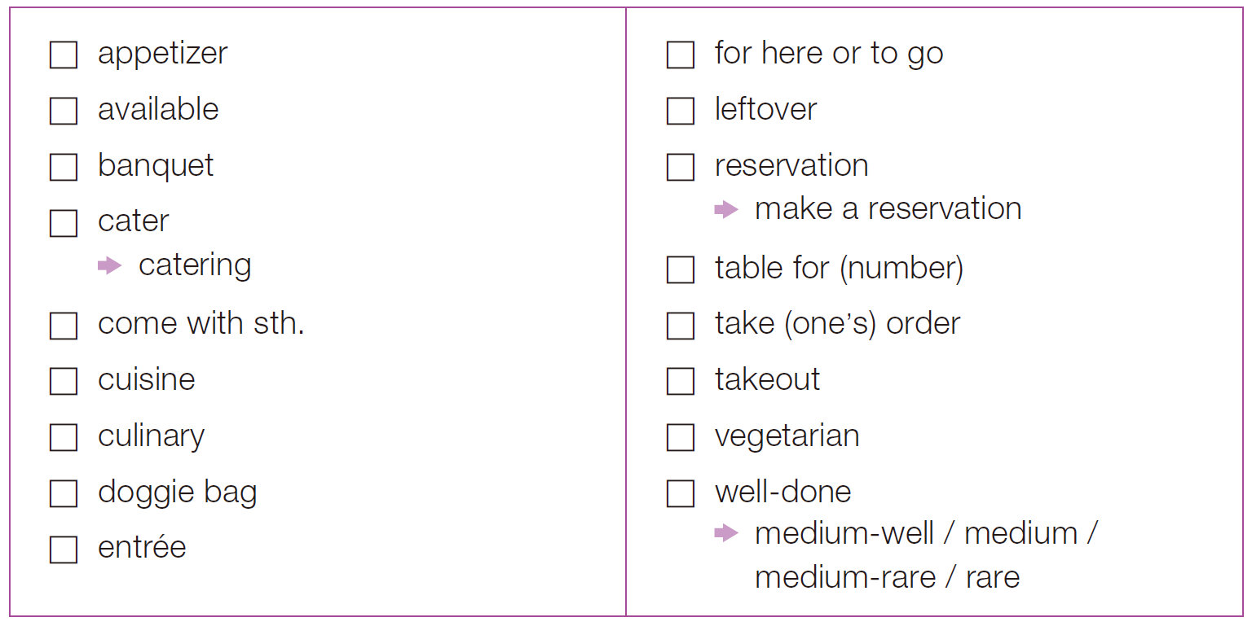
實戰篇 Unit 3
Word Power
將以下你已認識的字詞打，並在右方寫下其中文意思。
(n.) 開胃菜
內用或外帶
(adj.) 可利用的
(n.) 剩菜
(n.) 宴會
(n.) 預約；預訂
(v.) 承辦筵席
訂位
(n.) 承辦酒席；提供飲食及服務
(幾人的) 座位
附有某物
為 (某人) 點餐
(n.) 菜餚
(n.) 外帶
(adj.) 烹飪的
(n./adj.) 素食者/素食的
供客人打包用的袋子
(adj.) (牛排) 八分~全熟的
(adj.) 七~八分熟
的 / 五分熟的
(n.) 主菜
(adj.) 三~四分熟的 / 一~三分熟的

Slide 36
實戰篇 Unit 3
Exercise
Conversation 1
Q: How many people are with the woman?
(A) One
(B) Three
(C) Five
(D) Eight
錄音內容
M: Welcome to the Red Rooster Restaurant. Do you have a reservation?
W: No, we don’t. And I need a table for six. Is that possible?
M: Let me see . . . I’m sorry. I’m afraid we don’t have a table for six available right now. It’ll be about a 20-minute wait.
W: That’s OK. Please put our name down and we’ll go for a walk and come back.
• wait (n.) 等待的時間

Slide 37
實戰篇 Unit 3
中文翻譯
男： 歡迎光臨紅雞餐廳，有訂位嗎？
女： 沒有，我需要六個人的座位，可以嗎？
男： 我看看……很抱歉，恐怕我們現在沒有六人的座位了，大概還要等二十分鐘。
女： 好，那請登記我們的名字，我們先去逛逛，稍後再回來。

Slide 38
實戰篇 Unit 3
Conversation 2
Q: What does the man ask for?
(A) A steak and salad
(B) A ticket to New York
(C) Soup and potatoes
(D) A breakfast menu
錄音內容
M: I’d like to order the New York steak. What does that come with?
W: The New York steak comes with potatoes, vegetables and your choice of soup or salad.
M: Let me get a salad with that. And I’d like the steak well-done, please.
W Sure. I’ll bring your glass of water in a minute.

Slide 39
實戰篇 Unit 3
中文翻譯
男： 我想要點紐約牛排，有哪些配菜呢？
女： 紐約牛排的配菜有馬鈴薯、蔬菜，還有湯或沙拉二選一。
男： 那我選沙拉，然後我想要全熟的牛排，謝謝。
女： 好的，稍後我會送上一杯水。

Slide 40

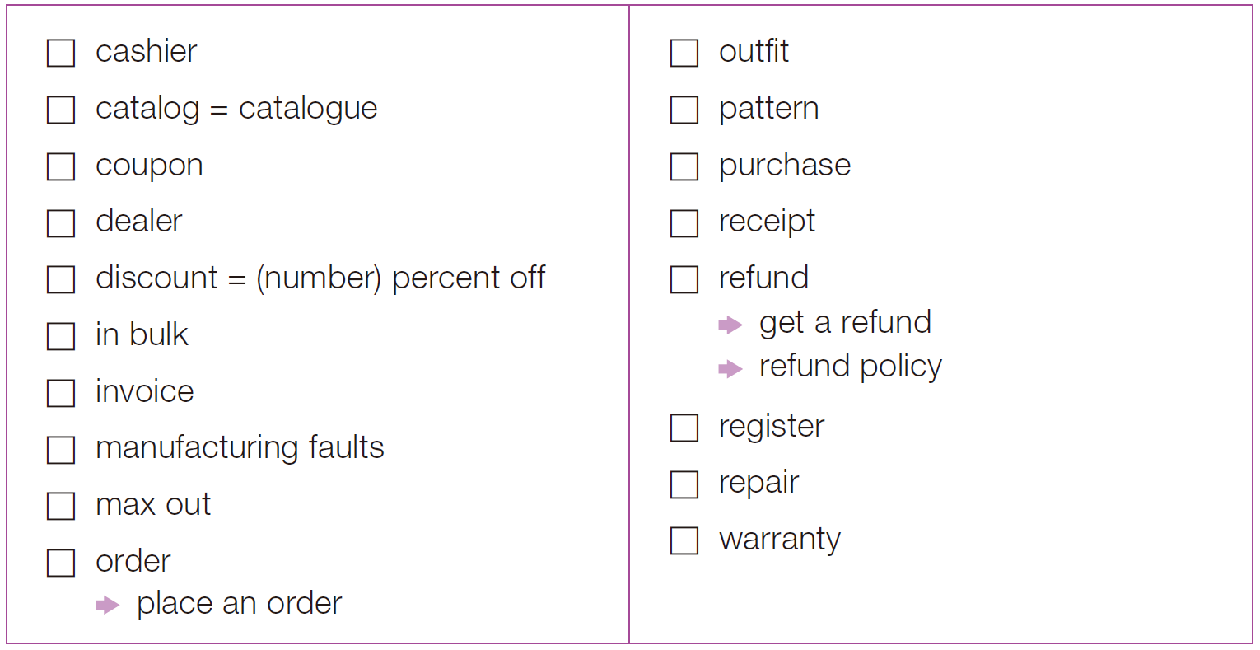
實戰篇 Unit 3
Word Power
將以下你已認識的字詞打，並在右方寫下其中文意思。
(n.) 收銀員
(n.) 全套服裝
(n.) 商品目錄
(n.) 圖樣；圖案
(n.) 折價券
(v./n.) 購買
(n.) 經銷商
(n.) 收據
(n.) 折扣
(v./n.) 退還；償還
大宗；大量
退款
退款政策
(n.) 發票
(n.) 收銀機
生產瑕疵
(v./n.) 修理；維修
刷爆 (信用卡)
(n.) 保證書；保固
(v./n.) 訂購；訂單
下訂單

Slide 41
實戰篇 Unit 3
Exercise
Conversation 1
Q: What does the man say about his pants?
(A) He couldn’t find his size at the mall.
(B) He got them at half price.
(C) He thinks they are too loose.
(D) He doesn’t like the color.
錄音內容
W: Uh, Jack? Who dressed you this morning? Those pants . . . well, they’re hideous!
M: Are you kidding me? I love this outfit. These pants were fifty percent off at the mall. I just love them! They have all of my favorite patterns rolled into one.
W: That’s exactly my point. Why don’t you let me handle the shopping next time? I’ll make sure your clothes aren’t more suited for clowns.
M: Oh, come on! They’re not that bad. Besides that, if I let you shop for me, you’d only max out our cards!
• hideous (adj.) 醜陋的；可怕的 • roll into one 使合為一體 • clown (n.) 小丑

Slide 42
實戰篇 Unit 3
中文翻譯
女： 呃，傑克，今天早上是誰幫你打扮的？這件褲子……嗯，看起來挺醜的！
男： 妳在開玩笑嗎？我超喜歡這身打扮。這褲子在購物中心買的時候還打了五折，我很喜歡呢！褲子上有所有我最愛的圖案，全部都融合在一起！
女： 這正是我想說的。不如，下次讓我和你一起去買衣服吧。我保證你買到的衣服不會像給小丑穿的。
男： 噢，拜託！這身衣服沒那麼糟糕吧！除此之外，如果我讓妳幫我買衣服，妳只會刷爆我們的卡！

Slide 43
實戰篇 Unit 3
Conversation 2
Q: What does Ms. Holden want?
(A) A new warranty
(B) A new product
(C) Her money back
(D) A repair
錄音內容
W: Listen. All I want is what you promised me at the time of purchase.
M: I didn’t promise unlimited repairs, Ms. Holden. I told you that you had unlimited use of our technical service hotline. This is all spelled out in your warranty. I included a copy in the envelope.
W: Right, the warranty. It says it is under warranty for a year.
M: What you’re asking for is not covered by the warranty. Only issues arising from manufacturing faults are covered. You’re talking about a problem that is a result of dropping it into a vat of chemicals at your factory.
• unlimited (adj.) 無限制的 • vat (n.) 大桶 • chemical (n.) 化學藥品

Slide 44
實戰篇 Unit 3
中文翻譯
女： 聽好，我想要的只不過是購買時你承諾的保證而已。
男： 我並沒有保證無限次數的維修，霍登女士，我只告訴過妳可以無限次數撥打我們的技術服務熱線，這在妳的保證書上寫得很清楚，我在信封裡放了一份影本。
女： 對，保證書，上面寫有一年的保固期。
男： 妳的要求並不在保固範圍內，只有因為生產上的瑕疵引發的問題才算。妳說的問題是因為妳將它掉入你們工廠裡裝有化學原料的大桶而引起的。

Slide 45
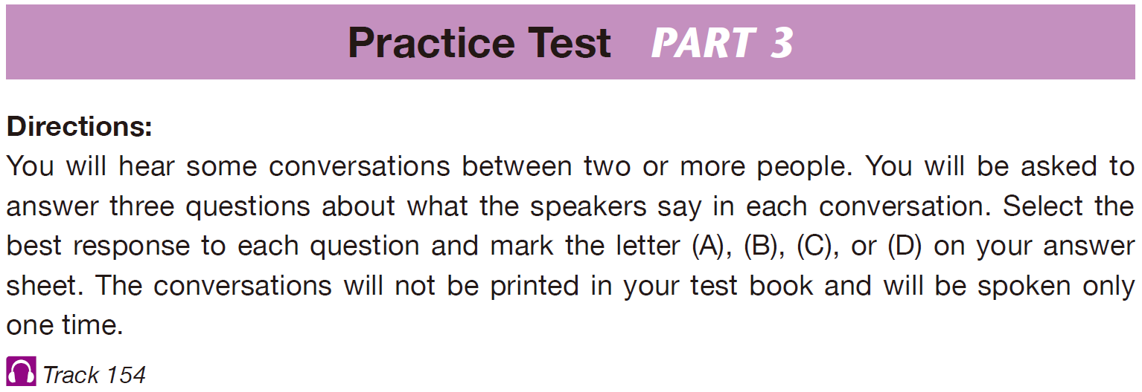
實戰篇 Unit 3

Slide 46
實戰篇 Unit 3
B
C
C
1. What are the speakers mainly talking about?
(A) Discount hotel rooms
(B) Available hotel rooms
(C) Going on a date
(D) Having a romantic dinner with an ocean view
2. What does the woman want to do?
(A) Make dinner reservations
(B) Arrange for transportation
(C) Make hotel reservations
(D) Find a room with a view
3. What is most likely true about the woman?
(A) She has four children.
(B) She wants to have a party in the hotel.
(C) She does not smoke cigarettes.
(D) She dislikes the ocean.

Slide 47
實戰篇 Unit 3
錄音內容
Questions 1-3 refer to the following conversation.
W: Hi, I’d like to reserve a hotel room for the 12th and 13th of next month—two nights.
M: OK, let me see . . . Would you like a single room or a double room?
W: I’d like a single room, please. And it has to be a non-smoking room.
M: No problem. Our whole hotel is non-smoking. A single room with a city view will be 87 dollars per night.
中文翻譯
女： 嗨，我想要訂房，訂下個月十二號和十三號，總共兩個晚上。
男： 好的，讓我看看……您想要單人房還是雙人房？
女： 我要一間單人房，謝謝，而且必須是一間禁煙房。
男： 沒問題，旅館內全面禁煙。有城市景觀的單人房一個晚上是八十七美元。

Slide 48
實戰篇 Unit 3
B
C
C
4. How will the man go to the department store?
(A) By train
(B) By bus
(C) By car
(D) On foot
5. Where does the man need to change buses?
(A) At the train station
(B) At the department store
(C) At the main bus station
(D) On Main Street
6. How long is the ride to the department store in total?
(A) 10 minutes
(B) 15 minutes
(C) 25 minutes
(D) 30 minutes

Slide 49
實戰篇 Unit 3
錄音內容
Questions 4-6 refer to the following conversation.
M: Hi, can you give me directions to the Main Street Department Store?
W: Sure. Take bus number 12 to the main bus station. Then take bus number 15
to the department store.
M: Bus number 12 and 15. Thank you. How long is the ride?
W: It’s about 10 minutes to the main bus station, and then another 15 minutes 3 from there. So about 25 minutes altogether.
中文翻譯
男： 嗨，可以請妳告訴我怎麼到緬因街百貨嗎？
女： 當然。先搭12路公車到公車總站，再搭15路公車到百貨公司。
男： 好的，12路公車和15路公車，謝謝。大約會搭多久呢？
女： 到公車總站大約十分鐘，之後再搭十五分鐘，所以大概總共需要二十五分鐘。

Slide 50
實戰篇 Unit 3
B
D
A
7. What is the conversation mainly about?
(A) Moving to a larger office building
(B) Hiring more employees
(C) Increasing production within the company
(D) Taking on new clients
8. What does the woman mean when she asks Stephen if he is “on board”?
(A) If he is physically in the room
(B) If he understands what was just said
(C) If he wants to stay with the company
(D) If he supports the decision
9. What does the first male speaker say about the company?
(A) The company is doing well and is receiving more business.
(B) The company recently fired some employees.
(C) The company is losing too many clients.
(D) The company should replace existing employees.

Slide 51
實戰篇 Unit 3
錄音內容
Questions 7-9 refer to the following conversation with three speakers.
W: I called this meeting today because I think our staffing numbers aren’t adequate.
MA: I agree. We have been receiving a higher demand of production lately. More employees would help us meet higher goals and expand our company further.
MB: How many people do you think we should hire?
MA: I could use at least two new people in my department.
W: Let’s start with that. Each of our departments will hire two new employees.
MA: OK, perfect.
W: Stephen, are you //on board//?
MB: Sure am.
W: Great, let’s begin recruiting this week.
• adequate (adj.) 足夠的

Slide 52
實戰篇 Unit 3
中文翻譯
女： 我今天召開這次會議是因為我認為我們的員工數量不足。
男A： 我同意。我們最近已經收到更多的生產需求。員工人數增多會幫助我們實現更高的目標並進一步擴展公司。
男B： 你認為我們應雇用多少人？
男A： 我的部門至少可以用兩個新人。
女： 我們一開始就先這樣吧。我們每個部門會雇用兩名新員工。
男A： 好的，完美。
女： 史蒂芬，你贊成嗎？
男B： 當然。
女： 太棒了，咱們這禮拜就開始招募員工吧。

Slide 53
實戰篇 Unit 3
B
C
C
10. What are the speakers mainly discussing?
(A) Where to purchase tools needed for work
(B) Job satisfaction
(C) Workplace gossip
(D) How to hire people
11. Why does the man not want to stay in his current job?
(A) He has difficulties with his manager.
(B) He doesn’t have the tools he needs.
(C) He wants to be in a management position.
(D) He wants a higher income.
12. What does the man think a manager should do?
(A) Make employees work hard
(B) Find ways to save the company money
(C) Give staff the things they need
(D) Give everyone a higher salary

Slide 54
實戰篇 Unit 3
錄音內容
Questions 10-12 refer to the following conversation.
W: Are you happy with your job or do you hope to get promoted someday?
M: I definitely want to get promoted. I was a manager at my last job, and I really like managing people.
W: What do you think is the most important part of managing people?
M: I believe a manager works for the employees. His or her job is to give them the tools they need.
中文翻譯
女： 你現在滿意你的工作嗎？還是希望有一天可以升遷？
男： 我當然希望能夠升職。我上一份工作的職位是經理，我非常喜歡管理員工。
女： 你認為管理員工最重要的是什麼？
男： 我認為經理就是為員工服務，他的工作就是提供員工所需。

Slide 55
實戰篇 Unit 3
A
C
D
13. What is the discussion mainly about?
(A) Storm preparations
(B) School cancellations
(C) Road conditions
(D) Winter activities
14. What does the first male speaker mean when he says, “They’re calling for a snowstorm”?
(A) Their city is in need of precipitation.
(B) A radio caller predicted the weather.
(C) The weather report foresees an approaching snowfall.
(D) Radio listeners should make preparations with their relatives.
15. What do all of the speakers imply?
(A) They are surprised by the news.
(B) They don’t like snow.
(C) The power is likely to go out.
(D) Leaving work early is a good idea.

Slide 56
實戰篇 Unit 3
錄音內容
Questions 13-15 refer to the following conversation with three speakers.
MA: I just heard about tonight’s weather on the radio. //They’re calling for a snowstorm.//
W: Well, that’s not good.
MB: What? You don’t like snow?
W: I do, but I don’t have any supplies at home in case the power goes out, and I need some groceries. And what if road conditions are too bad to drive tomorrow?
MB: It hasn’t started snowing yet. You can still go to the store after work.
MA: Actually, you might want to leave a little early, just to be safe.
W: Yeah! That’s a good idea.
MB: You know what? I think I’m gonna do the same.
• supply (n.) 補給品；用品（常用複數） • grocery (n.) 食品雜貨（作此義時常用複數）

Slide 57
實戰篇 Unit 3
中文翻譯
男A： 我剛才聽到收音機在播報今晚的天氣。他們預測會有暴風雪。
女： 嗯，那真是不妙。
男B： 什麼？妳不喜歡雪嗎？
女： 我喜歡啊，但萬一停電的話，我家裡沒有任何補給品，然後我需要一些食品雜貨。而且明天要是路況太糟不能開車的話怎麼辦？
男B： 現在還沒開始下雪。妳還是可以在下班後去一趟商店。
男A： 事實上，妳也許會想早點離開，為了安全起見。
女： 對啊！那是個好主意。
男B： 妳知道嗎？我想我也會這麼做。

Slide 58
實戰篇 Unit 3
D
C
D
16. What mistake did Sarah make?
(A) She sat next to the head of the company.
(B) She insulted her boss at a meeting.
(C) She gossiped about her coworkers.
(D) She said the project was not important.
17. What does the woman say Sarah needs to learn?
(A) How to organize a meeting
(B) When to offer the final price in a negotiation
(C) How to remain quiet
(D) What to say to potential customers
18. What does the man say was the result of Sarah’s comments?
(A) Sarah was asked to be the team leader.
(B) Sarah helped the team receive more money.
(C) The meeting came to an end abruptly.
(D) Sarah created a difficult situation.

Slide 59
實戰篇 Unit 3
錄音內容
Questions 16-18 refer to the following conversation.
M: What was Sarah doing in that meeting? You know who she was sitting next to? Sarah was right next to the head of the company. And she went off and said the whole project was a waste of our time.
W: I know. I talked to her after the meeting. She’s going to have to learn how to keep her thoughts to herself.
M: Our group has spent months on this project and now our funding might get cut. I can’t believe what a mess she’s made.
W: It’s nothing that can’t be fixed.
中文翻譯
• funding (n.) 資金
男： 莎拉在剛剛的會議上到底在做什麼？妳知道她旁邊坐的是誰嗎？是公司的大老闆！而她竟然直接說整個計畫根本就是浪費時間！
女： 我知道。會後我和她談過了，她該學學怎麼把自己的想法放在心裡就好。
男： 我們這一組為了這個計畫籌備了好幾個月，現在資金卻可能被砍掉。我真不敢相信她竟然把事情搞得一團亂。
女： 沒什麼是不能解決的事。

Slide 60
實戰篇 Unit 3
A
B
C
19. What is the man trying to do?
(A) Explain something
(B) Offer advice
(C) Persuade a listener
(D) Sell a product
20. What problem does his assistant have?
(A) She can’t update the man’s schedule.
(B) She doesn’t understand specialized language.
(C) She has no time for lengthy chitchat.
(D) She messed up his coffee order.
21. What is Danny probably going to do?
(A) Get a computer engineer
(B) Install the new software
(C) Help the secretary
(D) Explain things to the man

Slide 61
實戰篇 Unit 3
錄音內容
Questions 19-21 refer to the following conversation.
M: You would think installing new software on the computer would be simple. My new assistant just can’t get it. I’m through with trying to explain this to her.
W: It would help if you could avoid all the technical jargon. You know she isn’t a computer engineer by trade. She is your assistant—she’s a secretary! You hired her to get you coffee and keep your schedule.
M: Yes, but this is something she needs to know how to do. And, I’m using the simplest way to explain it that I can.
W: Well, apparently it’s not helping her in the least. Can’t you ask Danny to show her what to do? He’s good at explaining things.
• jargon (n.) 行話 • apparently (adv.) 明顯地

Slide 62
實戰篇 Unit 3
中文翻譯
男： 妳會覺得在電腦上安裝軟體很容易，我的新助理卻怎麼老是搞不清楚。我已經不想再嘗試解釋給她聽了。
女： 如果你不講那些專業術語的話可能會好一點。你知道，她的職業不是電腦工程師。她只不過是你的助理――一個秘書啊！你只是雇用她幫你倒咖啡和安排行程而已。
男： 對，但她應該要知道這怎麼做，而我已竭盡所能用最簡單的方式解釋給她聽了。
女： 嗯，顯然這對她一點幫助也沒有。你不能請丹尼教她一下嗎？他非常擅長解釋事情。

Slide 63
實戰篇 Unit 3
A
B
D
22. What does the woman think about new computers?
(A) They are easy to set up.
(B) They are harder to set up.
(C) They are expensive.
(D) You need an expert to set them up.
23. What does the man imply?
(A) That he needs a new computer.
(B) That he is not very good with computers.
(C) That the woman is worried about him.
(D) That he will make dinner for the woman.
24. What does the woman want for her help?
(A) She wants to be paid.
(B) She wants the man to learn.
(C) She wants to try the new machine.
(D) She wants a free dinner.

Slide 64
實戰篇 Unit 3
錄音內容
Questions 22-24 refer to the following conversation.
M: Can you come over tonight and help me set up my new computer and printer? They arrived this morning.
W: Sure, but new computers are usually easy to set up these days. It’s usually just plug and play.
M: I’d feel better if I had someone who knew what they were doing there. I’m worried I’ll do something wrong.
W: Fine. I’ll get you connected to the Internet and hook up the printer for you. But dinner’s on you, OK?
• plug (v.) 給……接通電源 • hook up 接通
中文翻譯
男： 可以請妳今天晚上過來一下，幫我安裝我的新電腦和印表機嗎？它們今天早上送來了。
女： 當然，不過現在的新電腦通常都很容易安裝，通常只要插上插頭就可以用了。
男： 如果有個知道該怎麼做的人在旁邊，我會比較安心。我擔心我會弄不好。
女： 好，我會幫你連接網路，並接通印表機，但晚餐你請，可以嗎？

Slide 65
實戰篇 Unit 3
A
C
C
25. What is the man and woman’s relationship?
(A) They work together.
(B) He is her client.
(C) He is her landlord.
(D) She is his waitress.
26. What does the man offer to do?
(A) Buy a book
(B) Get a menu
(C) Make a reservation
(D) Make a delivery order
27. What advantage does the Grand Café have?
(A) It has great Japanese food.
(B) It is less expensive.
(C) It has more variety.
(D) It will impress clients.

Slide 66
實戰篇 Unit 3
錄音內容
Questions 25-27 refer to the following conversation.
W: Let’s make tomorrow’s meeting a lunch meeting. We can take our clients out to a good restaurant to impress them.
M: OK. I’ll call and book a table. Do you want to try the new Japanese restaurant?
W: No, let’s find a restaurant with more variety so everyone will find something they want.
M: Good idea. The Grand Café downstairs has both Chinese and Western food. I’ll book a table there.
• book (v.) 預訂 • variety (n.) 多樣化；變化
中文翻譯
女： 我們把明天的會議改成午餐聚會吧！我們可以帶客戶到不錯的餐廳吃飯，讓他們留下好印象。
男： 好的，我會打電話訂位。你想吃吃看新的日式餐廳嗎？
女： 不，找間有多樣菜色選擇的餐廳，這樣每個人都能找到自己喜歡的食物。
男： 好主意。樓下的格蘭特咖啡館中西式的食物都有。我去訂位。

Slide 67
實戰篇 Unit 3
C
B
B
28. What is most likely the woman’s occupation?
(A) A real estate agent
(B) A tour guide
(C) A bank teller
(D) A stockbroker
29. What does the woman need before she can put the money in the man’s account?
(A) A handwritten check
(B) A completed deposit slip
(C) A withdrawal form
(D) A money order
30. What will the woman do next?
(A) Fill out a deposit slip
(B) Take care of the checks
(C) Get the man his money
(D) Fill out a withdrawal form

Slide 68
實戰篇 Unit 3
錄音內容
Questions 28-30 refer to the following conversation.
M: I’d like to deposit these checks into my account, and also withdraw 300 dollars.
W: No problem. I’ll need you to fill out this deposit slip and this withdrawal form.
M: I’ve already filled out a deposit slip—here you are. But I didn’t have a withdrawal slip.
W: That’s OK. Please swipe your card and enter your PIN number. I’ll take care of the checks first, and then get you your money.
• PIN 個人識別碼；密碼（= personal identification number）
中文翻譯
男： 我想將這些支票存進戶頭，並再提三百美元。
女： 沒問題，請填寫這張存款單和提款單。
男： 我已經填好存款單了，在這裡。但我沒有提款單。
女： 沒關係，請在這裡刷卡並輸入密碼。我會先處理這些支票，之後再幫你辦理提款。

Slide 69
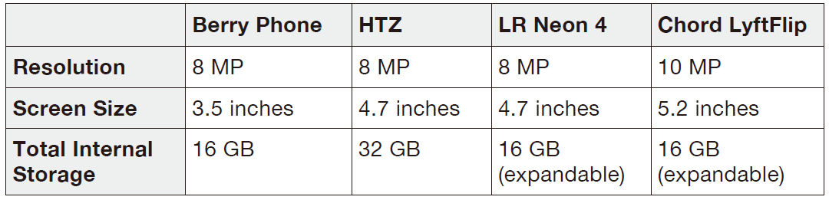
實戰篇 Unit 3
B
B
A
31. What is the purpose of making a list?
(A) To show the clerk at the store
(B) To figure out what kind of phone the man needs
(C) To impress people with the man’s writing
(D) To give to a friend who can help buy a phone
32. What does the woman say the man should do online?
(A) Find out what he wants to do with a phone
(B) See how much phones cost if bought online
(C) Learn about what smartphones cannot do
(D) Make a list of what he wants to do
33. Look at the graphic. Which of the listed phones would the man most likely prefer?
(A) Berry Phone
(B) HTZ
(C) LR Neon 4
(D) Chord LyftFlip

Slide 70
實戰篇 Unit 3
錄音內容
Questions 31-33 refer to the following conversation and table.
M: I want to buy a new smartphone, but there are so many to choose from. How do I know what to buy?
W: Simple. Make a list of what you want to do with it. Then study the features on different phones.
M: Should I buy it online or from a cell phone store?
W: Check the prices online, and then compare them with prices at stores. You can also get advice from salespeople at stores.
M: I don’t need a lot of fancy features or apps, so I know I don’t really need a lot of internal storage.
W: OK, that helps narrow down your choices. What do you think of mine? It’s the Neon 4.
M: Definitely not one like this. The screen is way too big for me.
• compare A with B 比較A和B

Slide 71
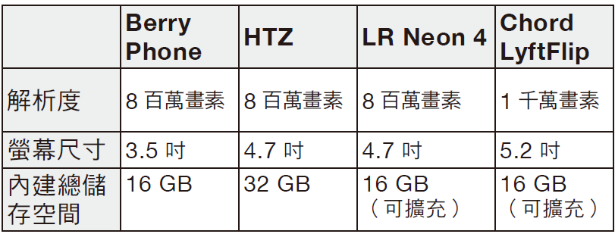
實戰篇 Unit 3
中文翻譯
男： 我想要買一支智慧型手機，但選擇太多了，我應該怎麼選擇想要的呢？
女： 很簡單，列表寫出你想要的用途，再研究一下不同手機提供的功能。
男： 我應該在網路上買還是到手機店買呢？
女： 先看看網路上的價錢，再和店內的價錢比較看看。你還可以從店裡的銷售人員那兒得到一些建議。
男： 我不需要很多酷炫的功能或是應用程式，所以我知道我並不需要很多的內建儲 存空間。
女： 好的，那就有助於縮小了你的選擇。你覺得我的手機如何？它是Neon 4。
男： 像這樣的手機絕對不是我要的。它的螢幕對我來說太大了。

Slide 72
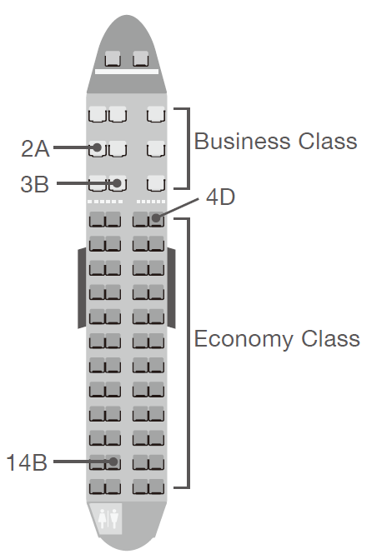
實戰篇 Unit 3
B
A
A
34. How many bags does the woman have?
(A) One
(B) Two
(C) Three
(D) Four
35. Look at the graphic. Where will the woman most likely sit?
(A) 3B
(B) 4D
(C) 14B
(D) 2A
36. When should the woman be at Gate 22?
(A) A half hour before the plane departs
(B) At two o’clock
(C) By early morning
(D) Later in the evening

Slide 73
實戰篇 Unit 3
錄音內容
Questions 34-36 refer to the following conversation and airplane seat map.
W: Hi, here are my ticket and passport. I’d like an aisle seat, please. I like to get up during flights.
M: I think we can arrange that. Please put your check-through bags up on the scale.
W: Here you are. I have only the one check-through bag. I’m going to carry this her one on.
M: Oh, I’m afraid that there are no aisle seats left in economy class. You could upgrade to business class for an additional $100, and then I could put in you in an aisle seat. Otherwise there are window seats in the back, or the front of economy class.
W: One hundred dollars is more reasonable than I thought it’d be. OK, I’ll take that option. Here’s my credit card.
M: Excellent. I’ll have your boarding pass in just a moment. Your flight is scheduled to depart at 2 p.m. Please be ready to board at 1:30 at Gate 22.

Slide 74
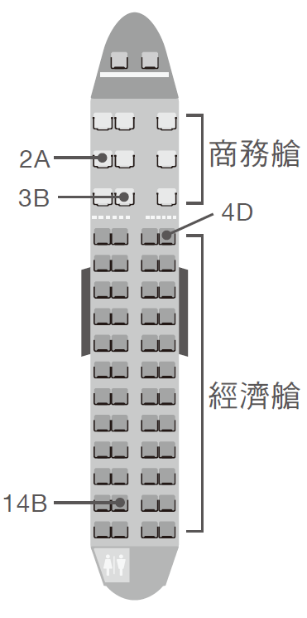
實戰篇 Unit 3
中文翻譯
女： 嗨，這是我的機票和護照。我想坐走道的位子，謝謝，我喜歡飛行期間起身活動。
男： 我想我們可以幫妳安排。請將要託運的行李放到秤上。
女： 在這裡，我只有一件行李要託運，另一件我要隨身攜帶。
男： 噢，經濟艙恐怕沒有走道的位子了。您可以多花一百元升級到商務艙，我就可以把您安排在走道的位子。不然的話就得選後面的靠窗座位或是經濟艙前面的靠窗座位。
女： 一百元比我原先想得還要合理。好，我接受。這是我的信用卡。
男： 太好了。我這就為您準備您的登機證。您的班機預定在下午兩點起飛。請於一點半在二十二號登機口準備登機。

Slide 75
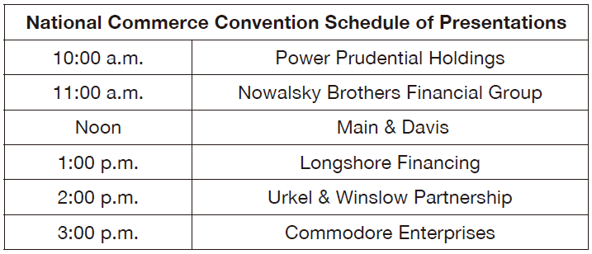
實戰篇 Unit 3
A
D
B
37. What will the man and woman tell people about at the convention?
(A) A feature available on a mobile store
(B) A device used for storage
(C) An update to their system
(D) A new service they offer
38. What does the man mean when he says, “There it is”?
(A) He knows where the convention is.
(B) He understands what the woman has said.
(C) He sees the schedule for the day.
(D) He’s referring to the location of the woman’s bag.
39. Look at the graphic and consider the conversation. Which company do the speakers work for?
(A) Power Prudential Holdings
(B) Main & Davis
(C) Urkel & Winslow Partnership
(D) Commodore Enterprises

Slide 76
實戰篇 Unit 3
錄音內容
Questions 37-39 refer to the following conversation and schedule.
W: Good morning, Tim. Are you ready to leave for the convention?
M: Just about. I need to grab my bag and then we can head out.
W: Ah . . . speaking of which, have you seen mine? Today’s schedule is in it.
M: //There it is.// I see it on the chair. Oh, and were you able to switch us to the last time slot?
W: No dice. Commodore Enterprises wouldn’t budge. The best I could do was to switch us with Longshore.
M: Man, it would have been great to make our announcement about our app at the end of the day, but an hour later than originally planned is better than nothing.
W: Yep. Shall we get going?
• no dice 不行；沒辦法 • budge (v.) 讓步；改變意見

Slide 77
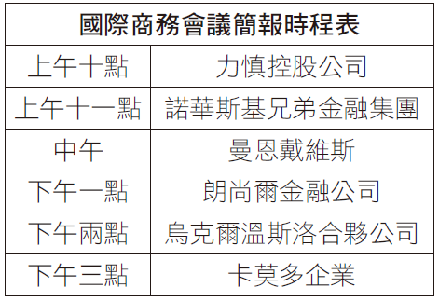
實戰篇 Unit 3
中文翻譯
女： 提姆，早。你準備好要去參加會議了嗎？
男： 快好了。我要去拿個包包然後我們就可以出發了。
女： 啊……提到包包，你有看到我的包包嗎？今天的行程表在裡面。
男： 在那兒呢。我看到在椅子上。喔，妳能把我們換到最後的時段嗎？
女： 不行。卡莫多企業不會願意換的。我能做的頂多就是和朗尚爾交換。
男： 天啊，要是能在最後宣布我們的手機應用程式那就太好了，但比原先計畫晚一個小時總比什麼都沒改變要好。
女： 對啊。我們可以出發了嗎？

Slide 78
實戰篇 Unit 3
「簡短對話」
主題類型與詞彙
-The End-

